Slide 1
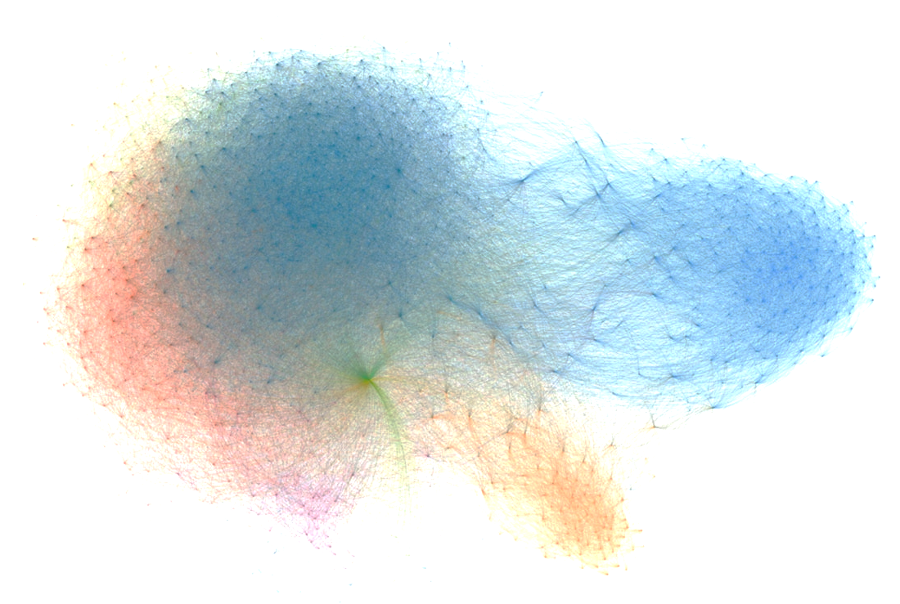
V I S U A L
QUESTION ANSWERING
M L D S F I N A L P R O J E C T
沈昇勳 r03942071
沈家豪 r04921047
廖宜修 r03921048
呂相弘 r03942039
吳彥諶 r03942044

Slide 2
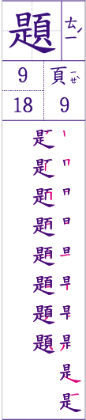
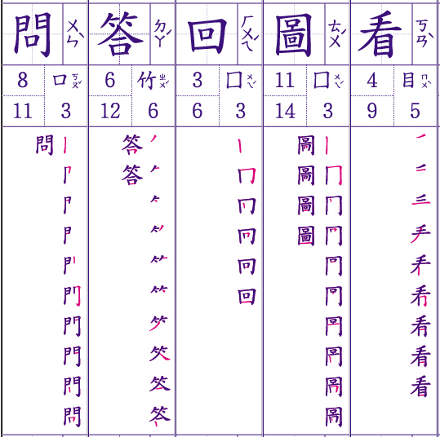
DEMO
VQA

Slide 3
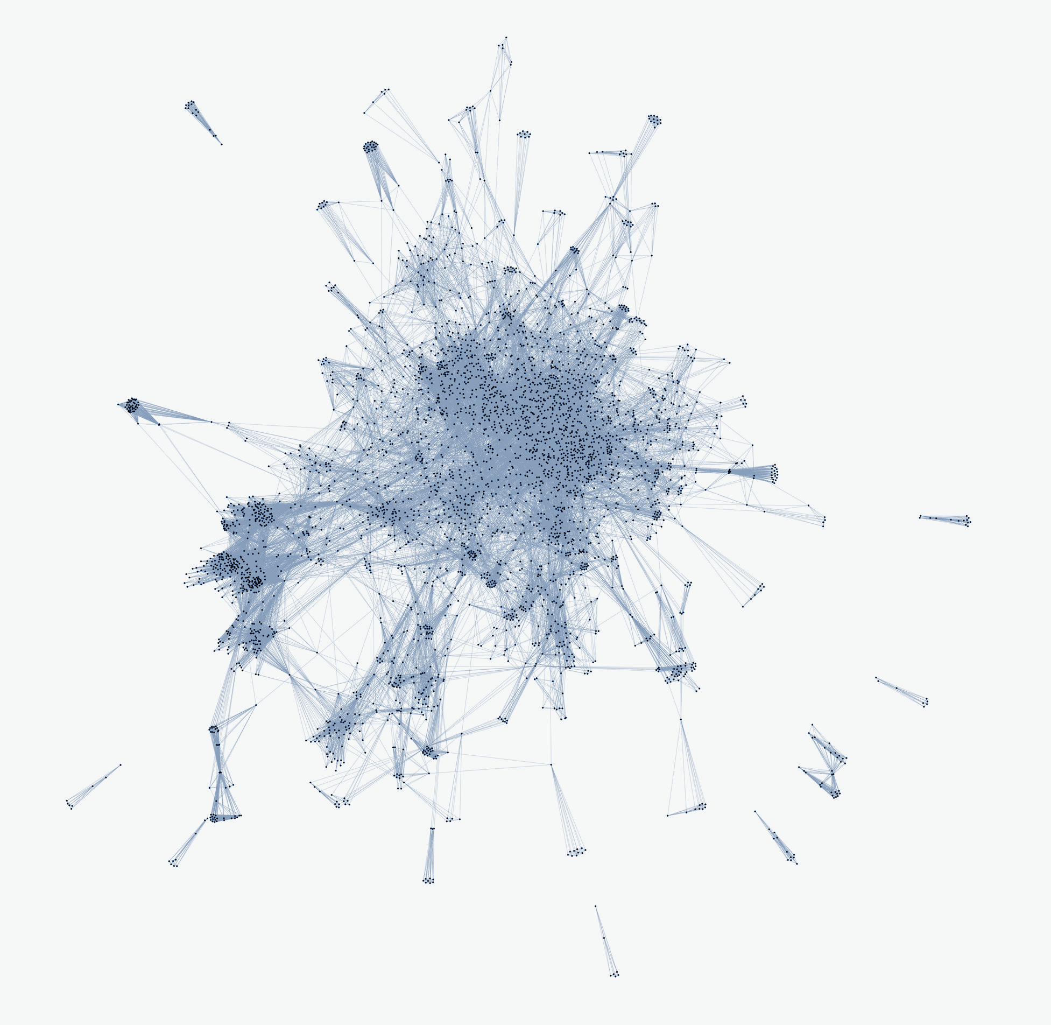
Task Definition
VQA

Slide 4

Question Answering
Answer questions according to corpora.
VQA

Slide 5
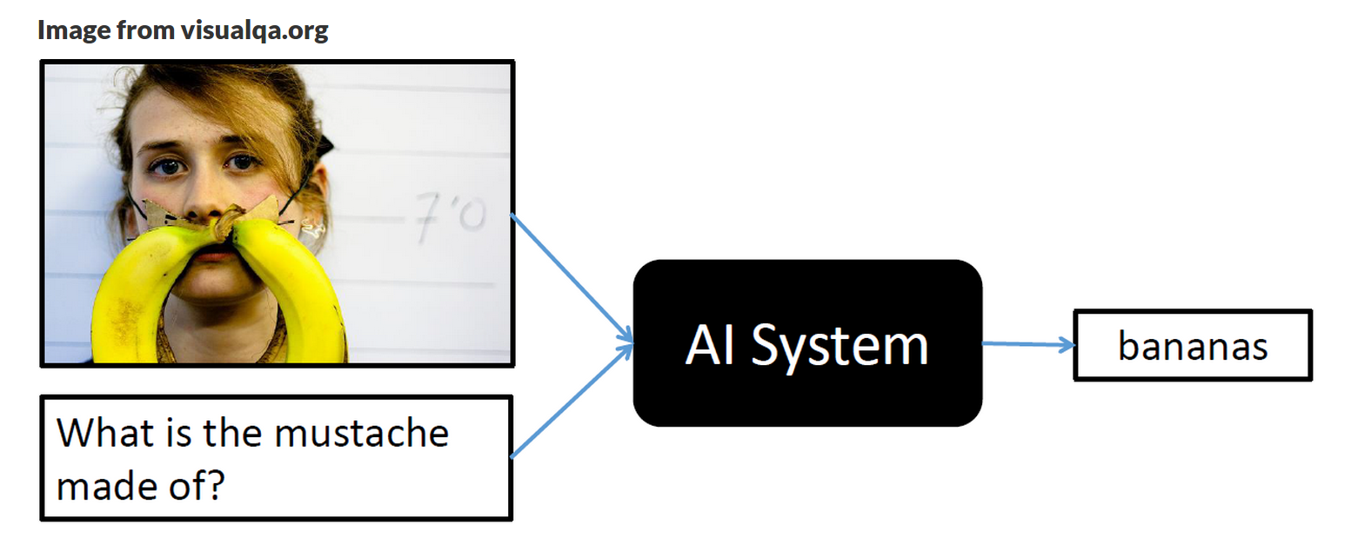
Visual Question Answering
Given a picture and a question, you need to report an answer according to the information in the picture.
VQA

Slide 6
Introduction to Dataset
VQA

Slide 7
Download
Training Images : 13.5 GB
download link2
Testing Images : 6.6 GB
download link2
Others : 11.5 MB
download
VQA

Slide 8
Training data
Image Set : 82,783 pictures
Question Set : 146,962 questions
Multiple Choices : 5 choices for each question
Answer
Annotation : some more information
VQA

Slide 9
Testing data
Image Set : 40,504 pictures
Question Set : 72,802 questions
Multiple Choices : 5 choices for each question
VQA

Slide 10
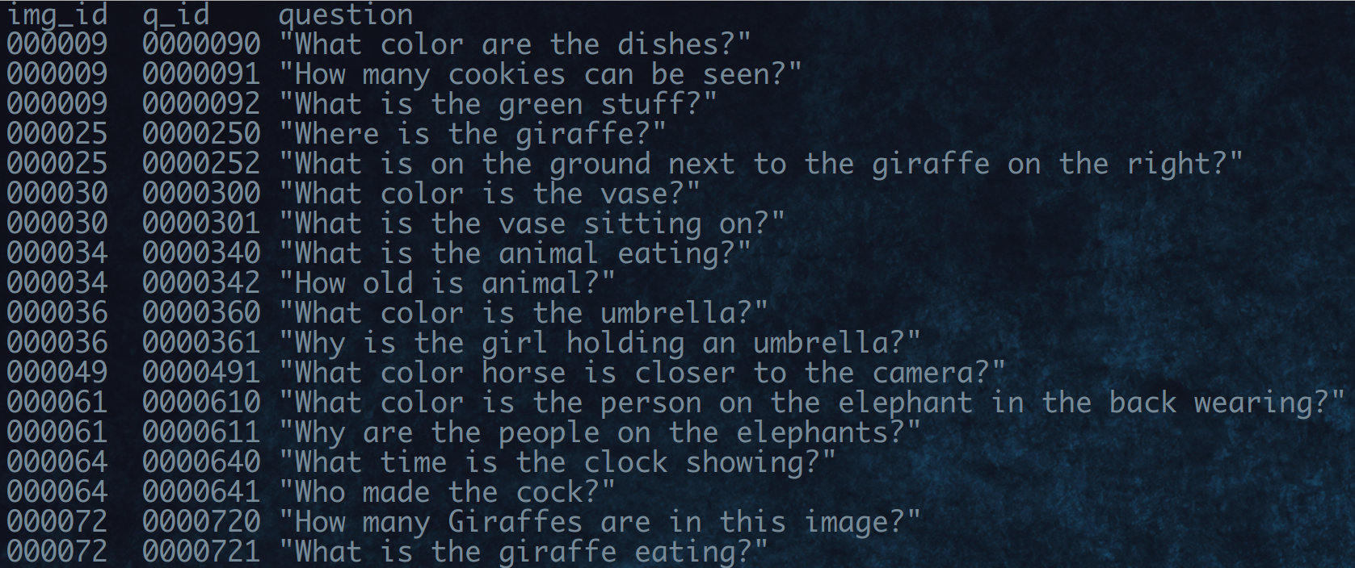
Data format
Question set
VQA

Slide 11
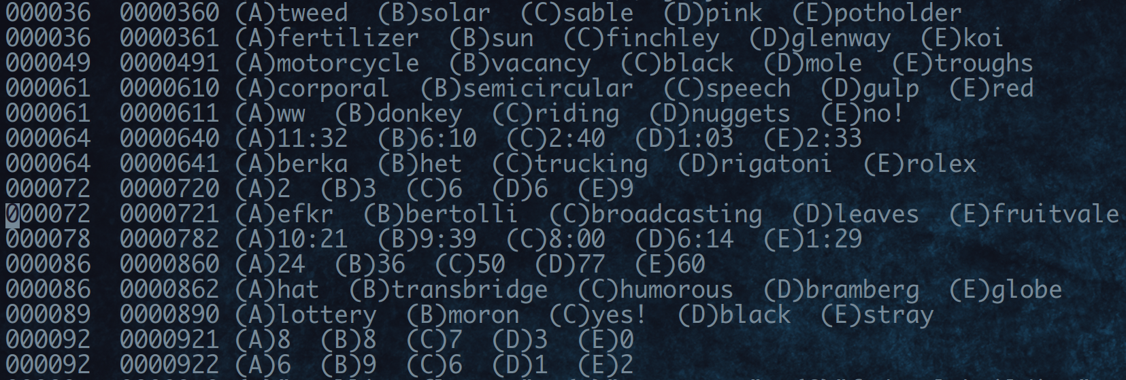
Data format
Multiple choices
VQA

Slide 12
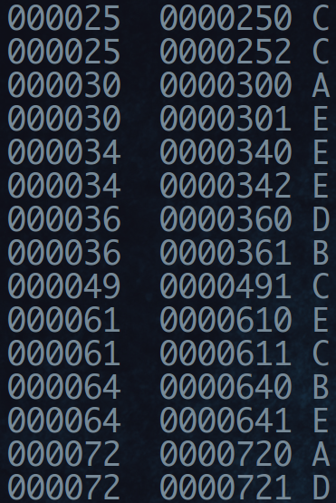
Data format
Answer
VQA

Slide 13
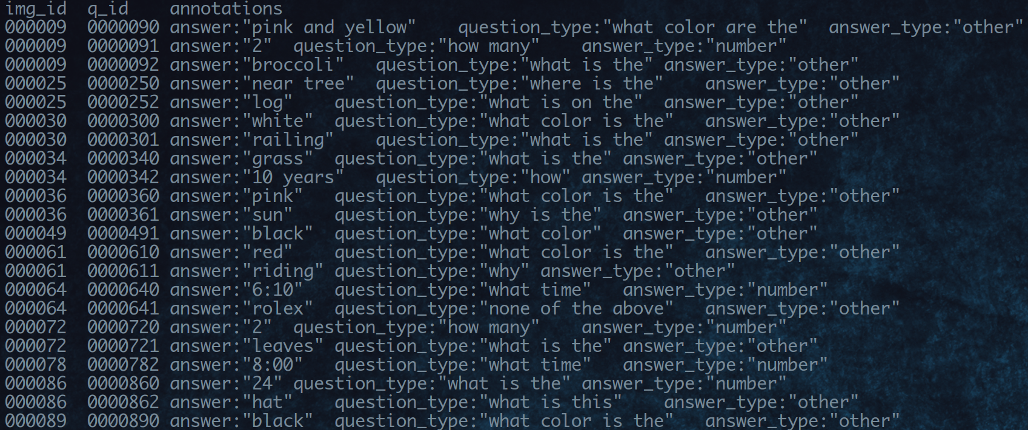
Data format
Annotation ( Optional )
VQA

Slide 14
Submission Format
VQA

Slide 15
Submission
Kaggle platform
https://inclass.kaggle.com/c/104-1-mlds-final-project
Submit your predict.csv on it
50 % public score and 50% private score
VQA

Slide 16
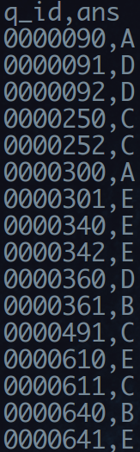
Submission format
predict.csv
VQA

Slide 17
User Guide
VQA

Slide 18
Think about what we have learned...
AGE OF
EMPIRE
DNN
RNN
WORD EMBEDDING
STRUCTURE
LEARNING
CNN
Haruhi Suzumiya
TAIWAN NO.1
VQA

Slide 19
Think about what we have learned...
Image → CNN feature extraction → image vectors
Question → Word embedding → word vectors
Answer → Word embedding → word vectors
and then…?
VQA

Slide 20
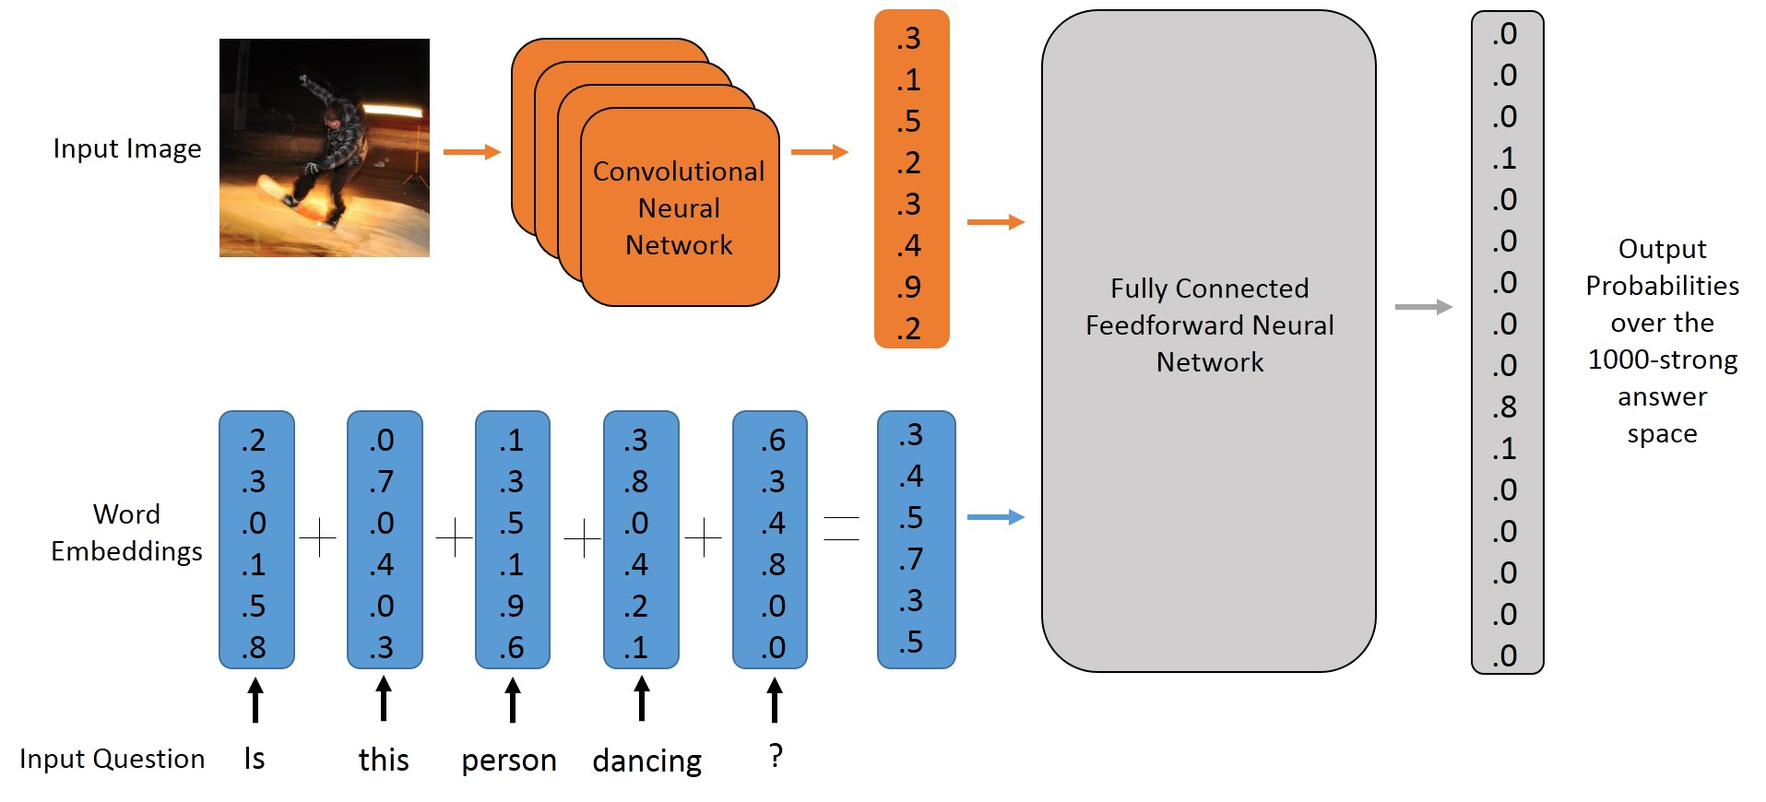
An undergraduate from MIT did this...
Blog :
https://avisingh599.github.io/deeplearning/visual-qa/
VQA

Slide 21
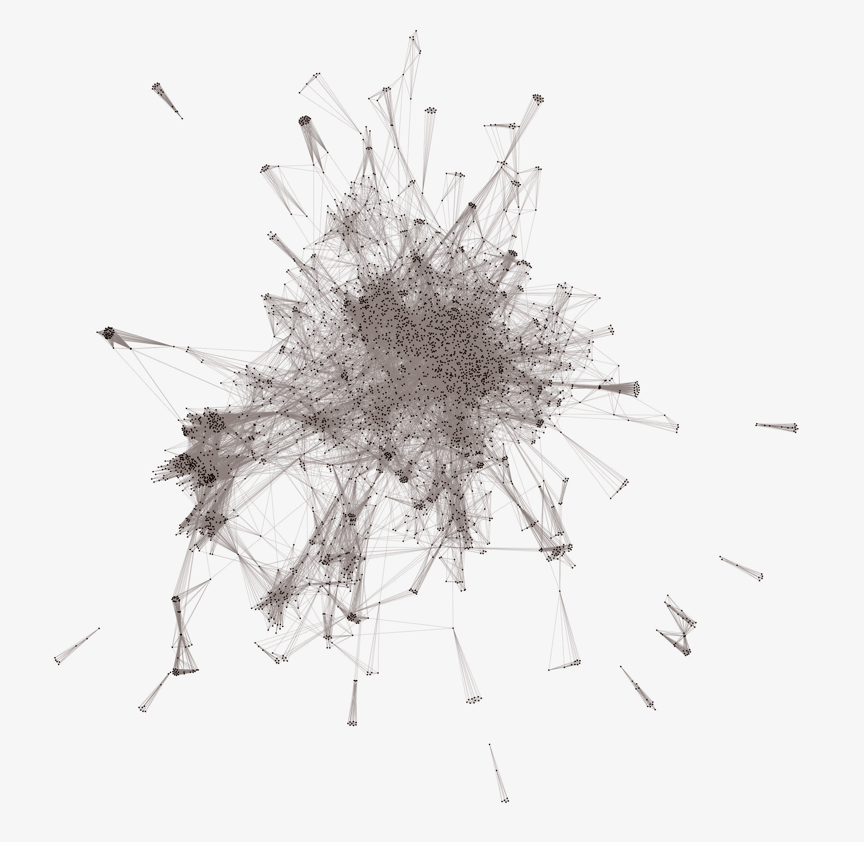
Some Rules
VQA

Slide 22
You can...
Use any toolkit ( Caffe, libsvm, libdnn … )
Use any library ( theano, Torch, Tensorflow … )
Use any open-source (github)
VQA

Slide 23
You can’t...
Answer questions by yourself
VQA

Slide 24
Other sources you can use
Any image data set ( e.g., ImageNet )
Any pre-trained image model (e.g., VGG, GoogLeNet )
Any text corpus ( e.g., Wikipedia )
Any knowledge base ( e.g., WordNet )
Any pre-trained word embedding model
But you can’t use this :
visualqa.org/download.html
VQA

Slide 25
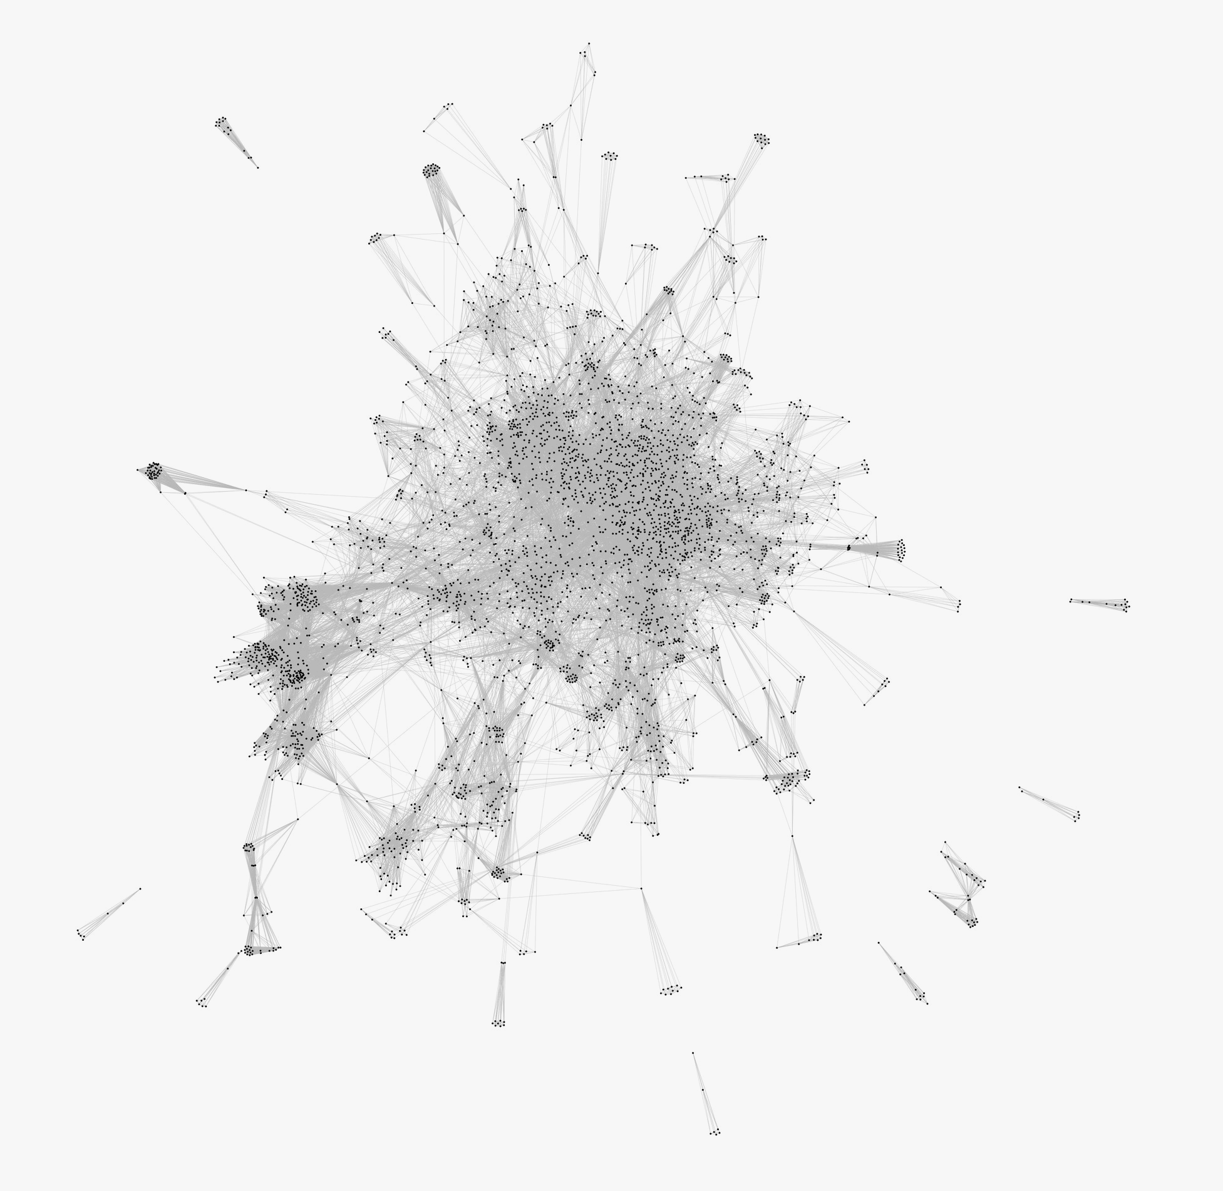
Presentation
VQA

Slide 26
Presentation
We will choose top 10 teams according to Kaggle scores.
Give a presentation, share what you have done.
You will get bonus scores.
VQA

Slide 27
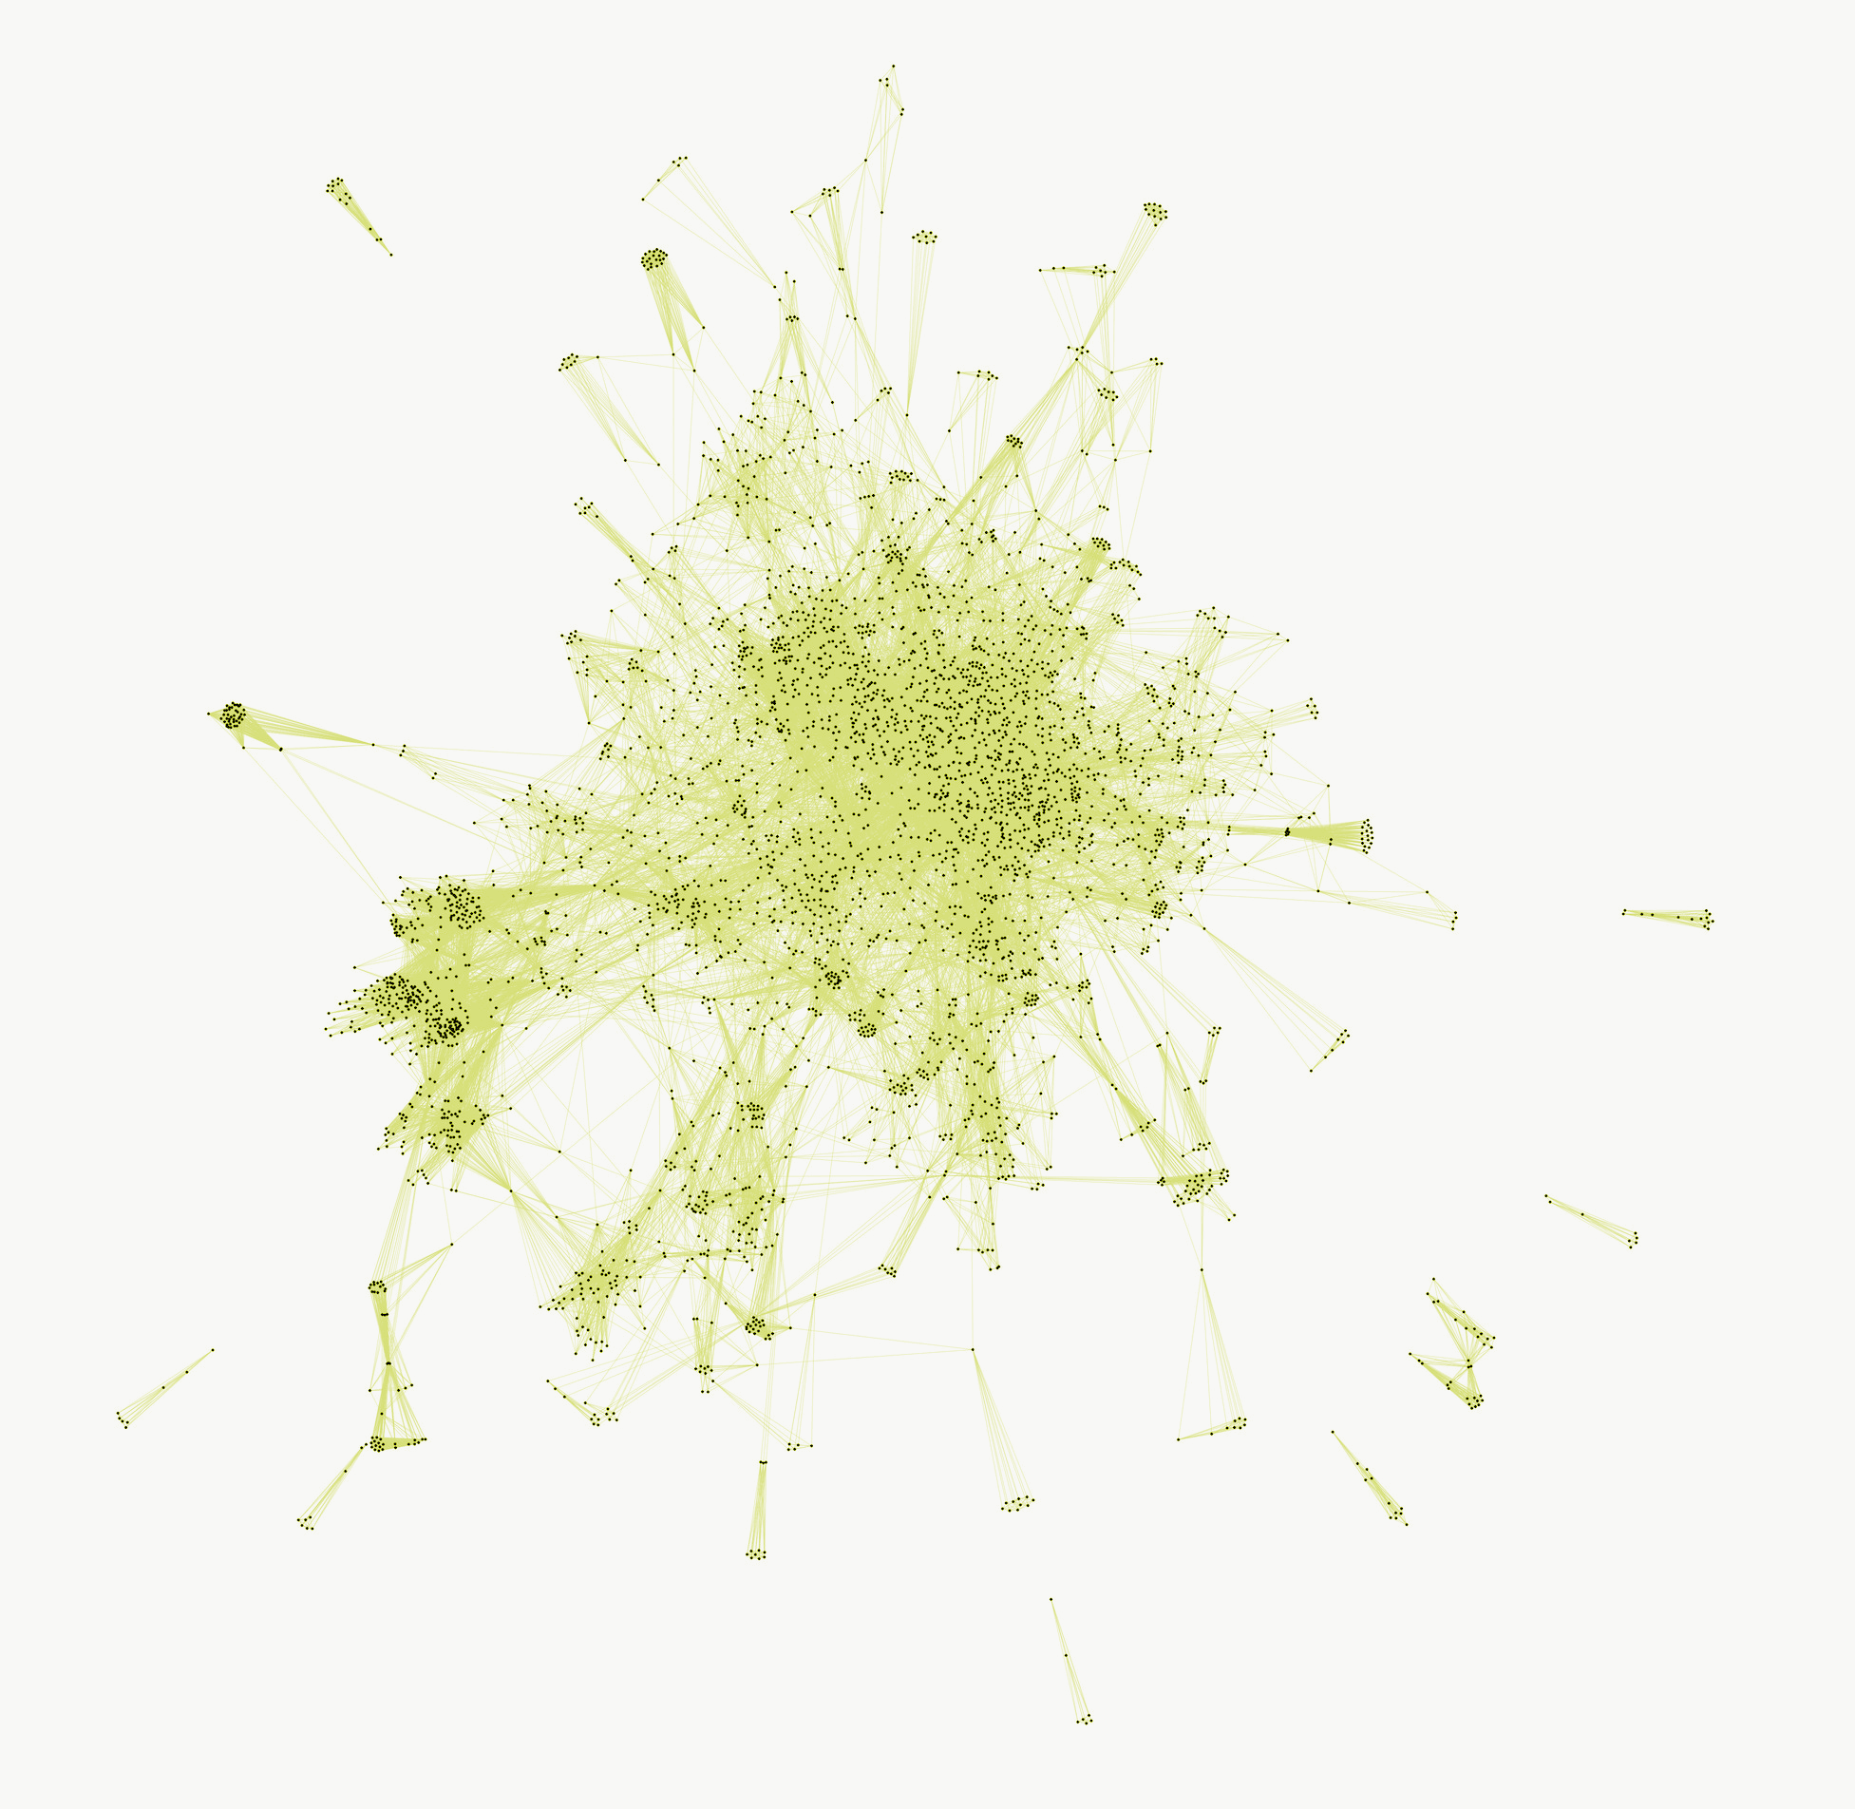
Schedule
VQA

Slide 28
Schedule
12/04 | Final project released
01/08 23:59 | Presentation deadline
01/13 23:59 | Presentation slides deadline
01/15 14:20 | Presentation
01/20 23:59 | Report deadline
VQA

Slide 29

Grading
VQA

Slide 30
Grading
Kaggle Accuracy 10%
Report 90%
Presentation
10 bonus

Slide 31
Grading - Report
Report (90%)
Group Information, Division of teamwork
Data Preprocessing/Flow Chart/Algorithm
What have you done?
Techniques, tricks
Experiments and Results
including charts & figures & comparsons
No more than 6 A4 pages with font size 12
包含封面封底(if any),reference
PDF format, or you will get zero credit

Slide 32
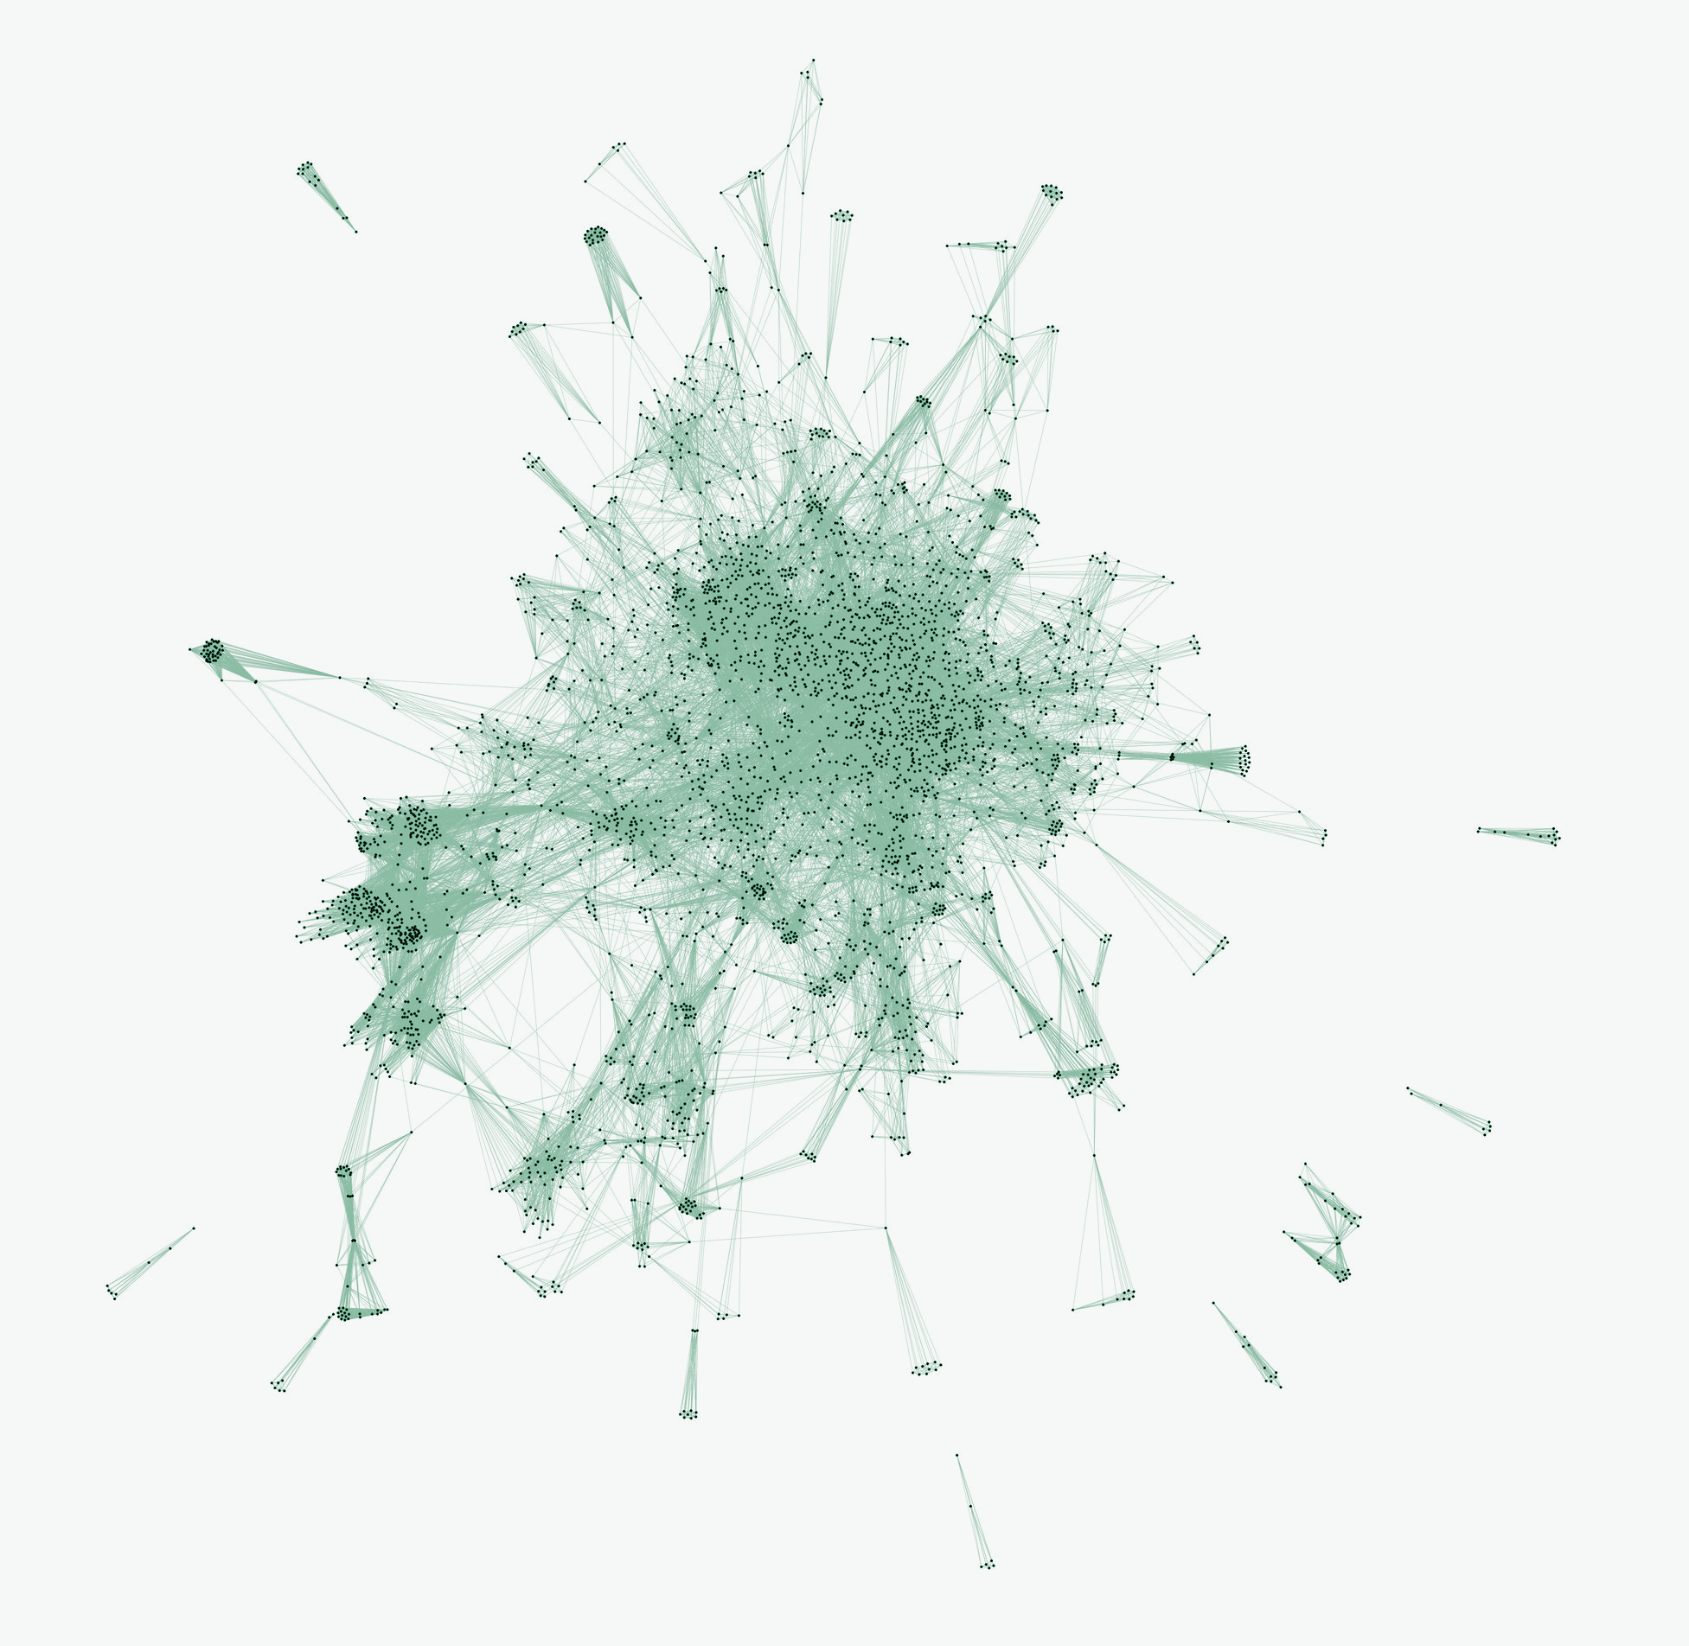
Appendix
VQA

Slide 33

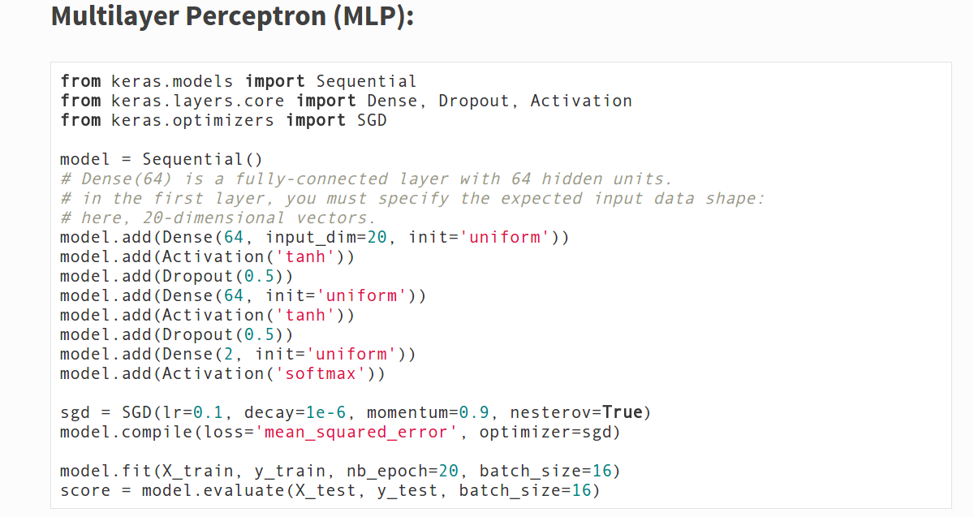
Keras | Deep Learning library for Theano and TensorFlow
–– Design your own neural networks in few minutes
Website : http://keras.io/
Example :
VQA

Slide 34
Introduction to Visual Question Answering
link
VQA

Slide 35
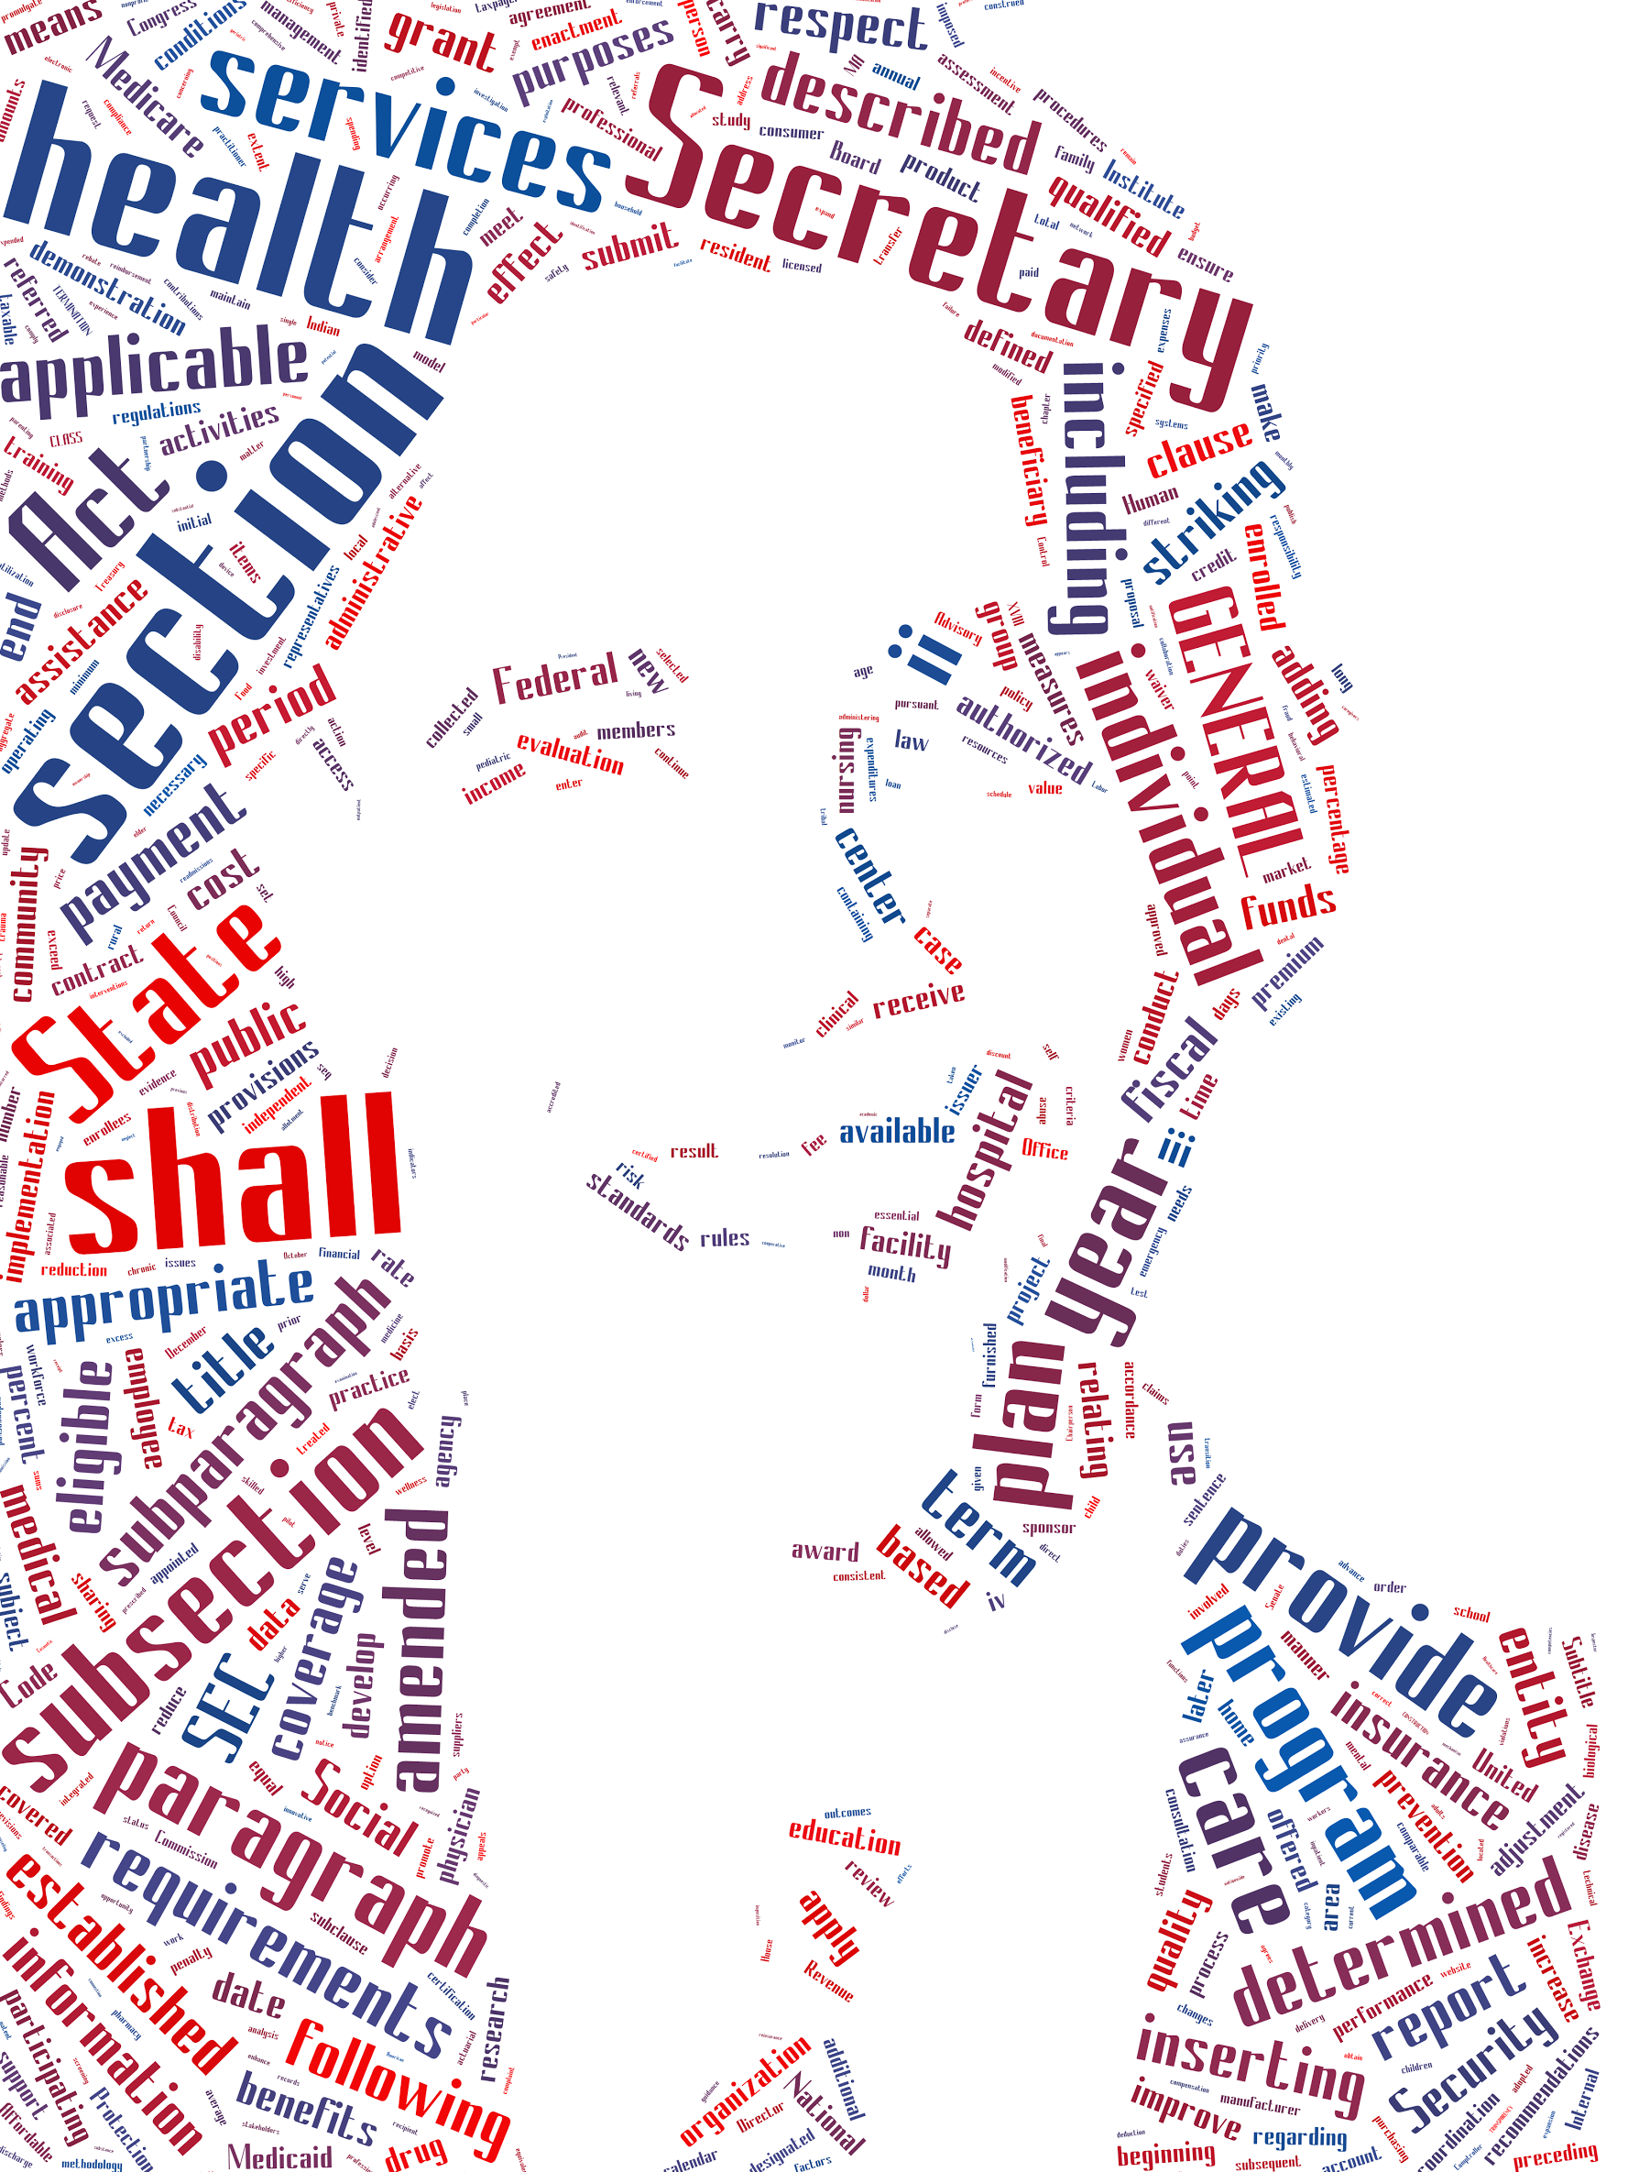
Have Fun.

